Slide 1
INMATE EVALUATION AND MANAEMENT SYSTEM(IEMS)
KELVIN NG’ANG’A IRUNGU
SB30/PU/42106/22
SUPERVISOR: MR. MWANGI

Slide 2
IINTRODUCTION
The existing systems in most prisons use paper-based technology. These tend to be very tedious, prone to alterations, have slow access speed and in case of disasters like fire, recovery is almost none as there are no backups.
IEMS aims at solving all these issues by incorporating robust user verification and authentication protocols, the system enables the assignment and storage of merit and demerit points within a modernized database infrastructure. By automating the evaluation process and generating comprehensive reports, IEMS facilitates informed decision-making regarding inmate eligibility for early release, thereby promoting transparency and accountability within the corrections system.

Slide 3
OBJECTIVES
To gather information about the existing prison management system and the criteria used in evaluating those who qualify for early release.
To analyze the functions that the system will perform in order to effectively design it. Such functions include storage of inmate data and rating them as per who qualifies for early release.
To create a simple design, which will highlight some core functions like input, search, and update using the dummy dataset.
To implement the Inmate Evaluation and Management System web application.

Slide 4
RESEARCH QUESTIONS
What were the suitable methods to be used to collect and gather information about the existing systems?
What would be the functions performed by the proposed system?
What were the best tools and approach to be used in actualizing the system?
What technology was the most suitable in implementing the system?

Slide 5
SCOPE OF THE PROJECT
The scope of this project was limited to the inmate’s registration details, discipline ratings and suggesting those qualified for early release. Due to the constraints of time and budget, it did not focus on other areas of a Prison.

Slide 6
SIGNIFICANCE OF THE PROJECT
Reduced running costs.
Kept of digital records that are tidier and require less physical space.
Processed data faster.
Increased confidence of the inmates.
Led to reduced overcrowding in prisons.
Increased self-health of the inmates and staff.
7. Provided further data security.

Slide 7
SYSTEM DEVELOPMENT METHODOLOGY
Agile method was the proposed approach as it provided a structure that fitted the changing needs of the Automated Inmate Evaluation and Management system. This project benefitted with agile approach due to its iterative nature that involves adjustment and improvement as users engage and project evolves.

Slide 8
SOFTWARE RESOURCES USED
Programming language: PHP
Web framework: Laravel
Databases: MySQL
GitHub
XAMMP Web Server
Visual Studio Code
Node JS

Slide 9
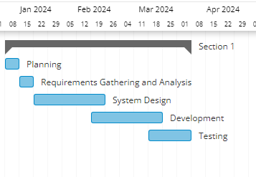
GANTT CHART

Slide 10
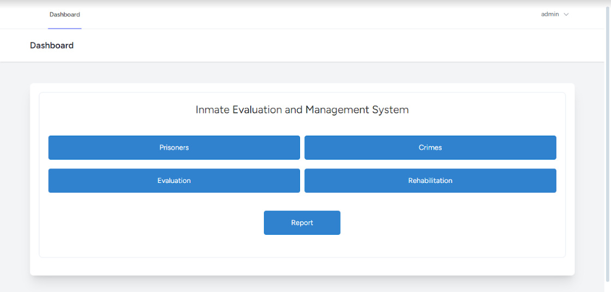
DASHBOARD

Slide 11
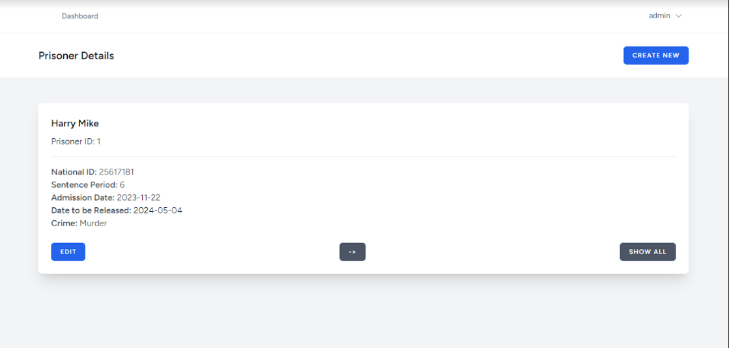
PRISONER RECORDS

Slide 12
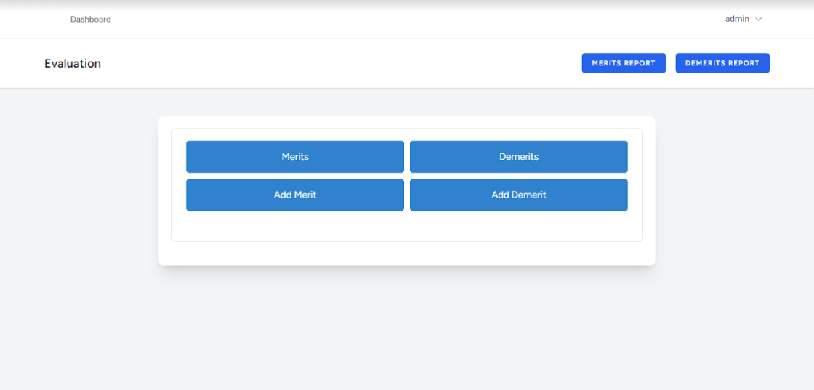
PRISONER EVALUATION

Slide 13
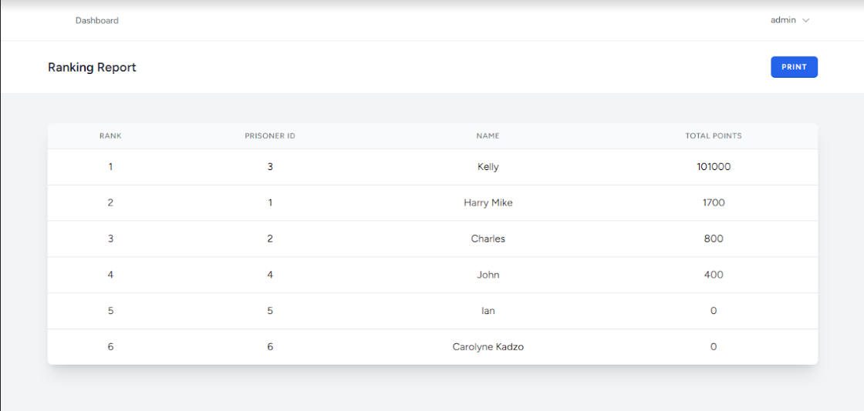
FINAL REHABILITATION REPORT

Slide 14
CONCLUSION
The Inmate Evaluation and Management System was a successful project. It has lightened the load of the current prison administrators in coming up with a list of the qualified prisoners for early release. It saves on costs as it reduces a lot of paperwork, security personnel to be employed to protect records, the panel to select the prisoners has also been cut down as most of the work is done by the system and also increased the speed of the process by making use of modern computing power. Further improvements may be done as policies change and new methods are employed. The system is modular enough to support incremental improvement.

Slide 15
RECOMMENDATIONS
Continuous enhancement: Regularly gather user feedback and incorporate new features and improvements to keep the application relevant to the country’s continuously changing policies.
Expanded usability: Explore opportunities to extend the application’s usefulness beyond prison systems. The algorithm may be altered to suit other areas that require behavioral evaluation and personal improvement.
Mobile application Development: A mobile application version may be created and the user levels of access may be increased. Instead of individual prisons viewing the data, various relevant government sectors may view. An overall report may be generated from the systems within all the prisons countrywide.
Exploration of emerging technologies: Technology is ever evolving. For example, AI has brought about a lot of functionality in the industry. By use of Machine learning and other new technologies, better evaluation methods may be integrated into the system.

Slide 16
THANK YOU

